Slide 1
Design and Analysis of Algorithms
Algorithms-II : CS345A
Website: hello.iitk.ac.in
Lecture 19
Depth First Search in Directed Graph - II

Slide 2





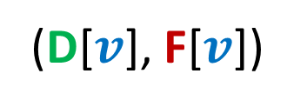
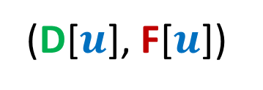








Relation between
(D[$u$], F[$u$])
and
(D[$v$], F[$v$])
Disjoint
One enclosing another
What about
D[$u$]
F[$u$]
D[$v$]
F[$v$]
D[$u$]
F[$u$]
D[$v$]
F[$v$]
D[$u$]
F[$u$]
D[$u$] < D[$v$] <F[$u$] < F[$v$] ?
D[$v$]
F[$v$]

Slide 3
Classification of non-tree edges
using
(D[$u$], F[$u$])
and
(D[$v$], F[$v$])

Slide 4

Classification of non-tree edges
There seems to be many different types of non-tree edges.
x
y
u
s
q
Can we classify the non-tree edges ?
w
j
r
p
v
t
b
d
h
c

Slide 5







($u$,$v$) is Forward edge
$$u$$
$$s$$
$$w$$
$$v$$
D[$u$]
F[$u$]
D[$v$]
F[$v$]

Slide 6

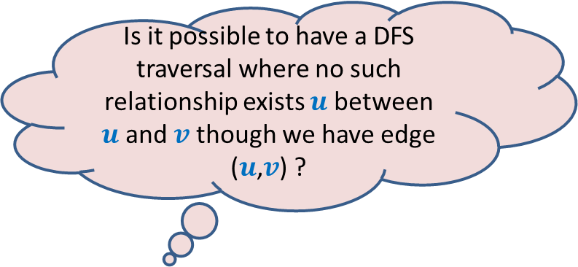









($u$,$v$) is Backward edge
Till now, we considered the situations in which either $u$ is ancestor of $v$ or vice versa.
$$v$$
$$s$$
Is it possible to have a DFS traversal where no such relationship exists $u$ between $u$and $v$ though we have edge ($u$,$v$) ?
$$w$$
$$u$$
Yes, indeed.
Think over it before moving to the next slide
D[$v$]
F[$v$]
D[$u$]
F[$u$]

Slide 7











($u$,$v$) is Cross edge
$$y$$
$$u$$
$$v$$
Is there any other type of non-tree edge ?
Think over it …
$$s$$
$$w$$
In the following slide, we shall show that these are the only possibilities of a non-tree edge.
$$x$$
D[$v$]
F[$v$]
D[$u$]
F[$u$]

Slide 8







Classification of non-tree edges
Consider an edge ($u$,$v$)
Case 1: ancestor to descendant
Case 2: descendant to ancestor
Case 3:
Tree edge or Forward edge
D[$u$]
F[$u$]
D[$v$]
F[$v$]
D[$v$]
F[$v$]
Backward edge
D[$u$]
F[$u$]
Cross edge
D[$v$]
F[$v$]
D[$u$]
F[$u$]
D[$u$]
F[$u$]
D[$v$]
F[$v$]

Slide 9
Classification of non-tree edges
x
y
u
s
q
w
j
r
p
v
t
b
d
h
c

Slide 10
Classification of non-tree edges
x
Forward edges
(u,w)
(b,c)
y
u
s
q
w
j
r
p
v
t
b
d
h
c

Slide 11
Classification of non-tree edges
x
Forward edges
(u,w)
(b,c)
y
u
s
q
w
j
r
p
v
t
b
d
h
c

Slide 12
Classification of non-tree edges
x
Forward edges
(u,w)
(b,c)
Backward edges
(t,u)
(j,u)
(r,q)
(c,b)
y
u
s
q
w
j
r
p
v
t
b
d
h
c

Slide 13
Classification of non-tree edges
x
Forward edges
(u,w)
(b,c)
Backward edges
(t,u)
(j,u)
(r,q)
(c,b)
Cross edges
(x,u)
(j,t)
(y,u)
(y,q)
y
u
s
q
w
j
r
p
v
t
b
d
h
c

Slide 14
Application - II
Computing Strongly connected components of a directed graph.

Slide 15


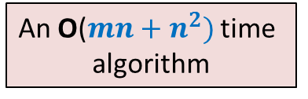
Strongly connected components
Definition: Two vertices $u$ and $v$ are said to be strongly connected if
$u$ is reachable from $v$
$v$ is reachable from $u$
A strongly connected component:
a maximal subset of “strongly connected vertices”
x
An O($m+n)$ time algorithm
An O($mn+n^{2})$ time
algorithm
y
u
v
q
b
d
w
j
r
p
h
c
t
k

Slide 16
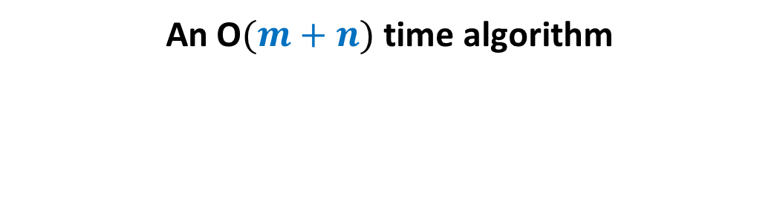
Computing SCCs efficiently
An O$(m+n)$ time algorithm

Slide 17
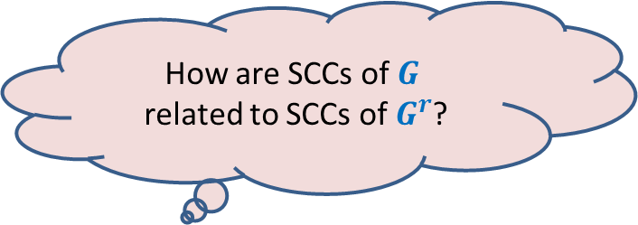
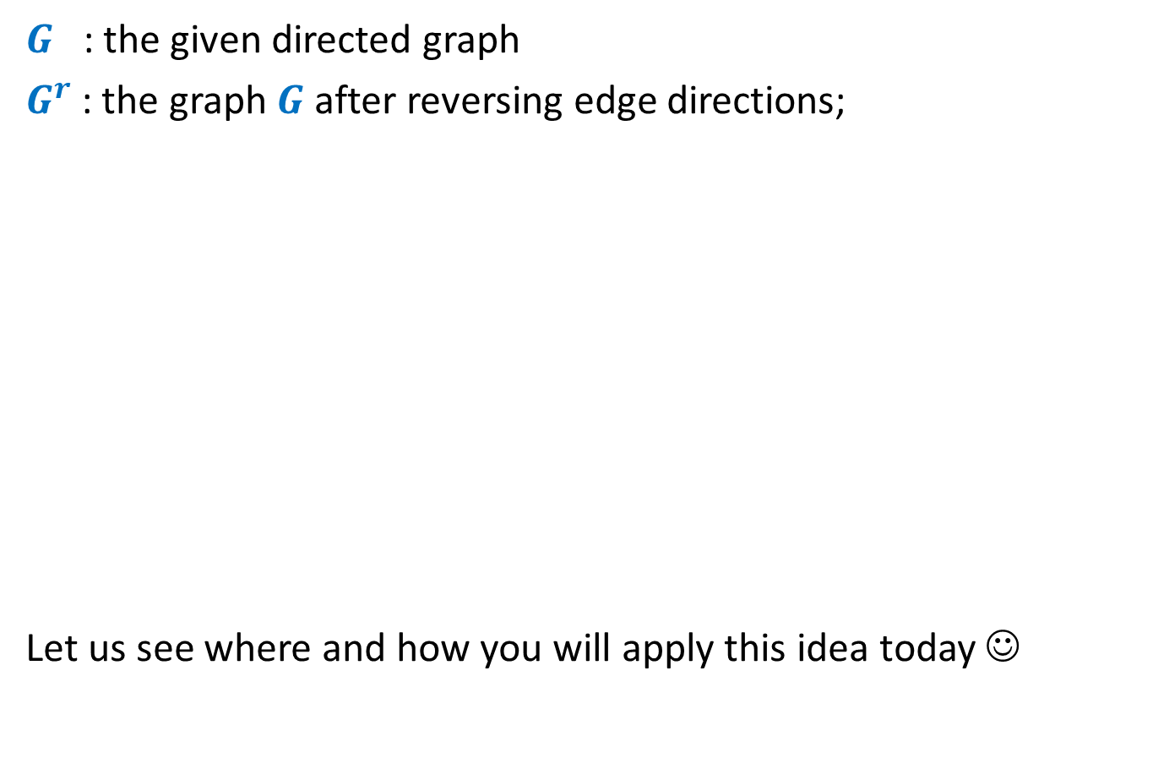


A simple yet powerful idea
$G$ : the given directed graph
$G^{r}$: the graph $G$ after reversing edge directions;
Let us see where and how you will apply this idea today ☺
SCCs of $G$
SCCs of $G^{r}$
How are SCCs of $G$
related to SCCs of $G^{r}$?

Slide 18
x
x
y
y
u
u
Lemma 1: An SCC will appear in exactly one tree in the forest of DFS trees .
v
q
v
q
w
j
w
j
r
p
r
p
k
t
k
t
b
b
d
d
h
h
c

Slide 19
x
x
x
y
y
u
u
Lemma 2: An SCC appears contiguously within its DFS tree.
v
q
y
v
q
w
j
w
j
r
p
r
p
z
k
t
k
t
b
b
d
d
h
h
c

Slide 20
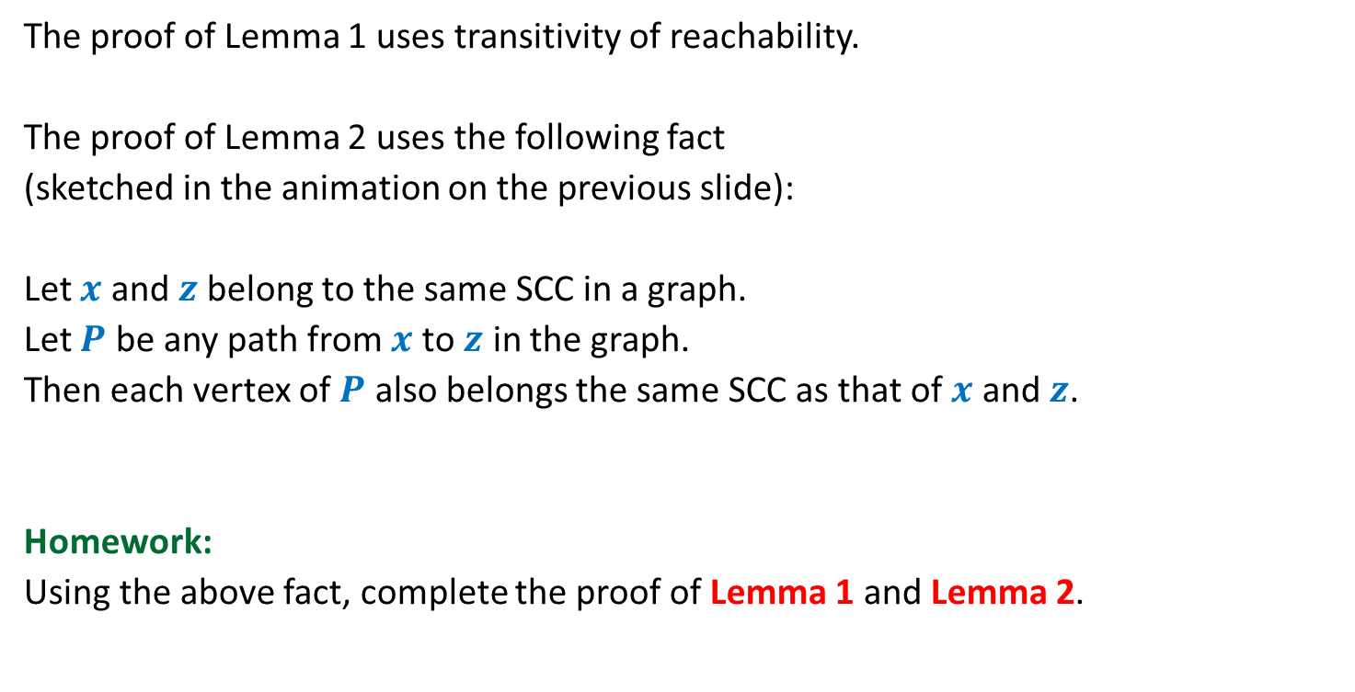
Proof of Lemma 1 and Lemma 2
The proof of Lemma 1 uses transitivity of reachability.
The proof of Lemma 2 uses the following fact
(sketched in the animation on the previous slide):
Let $x$ and $z$belong to the same SCC in a graph.
Let $P$ be any path from $x$ to $z$ in the graph.
Then each vertex of $P$ also belongs the same SCC as that of $x$ and $z$.
Homework:
Using the above fact, complete the proof of Lemma 1 and Lemma 2.

Slide 21
x
y
Try to spot the roots of SCC in the DFS forest.
u
Notation (root of an SCC):
the vertex of the SCC
which is visited first during the DFS
v
q
w
j
r
p
k
t
Having seen nice structure of SCCs in the DFS forest, we feel motivated to design an efficient algorithm based on DFS.
But how should we start with ?
b
d
h
c

Slide 22
Study Finish time
u
u
There does not appear to be any order ☹.
v
v
q
q
w
j
w
j
r
p
r
p
t
k
t
k
t w k j v r p q u
Increasing order of F[]

Slide 23
Searching for an order using Finish time
It looks too complex !
SCC A
SCC D
Increasing order of F[]
SCC B
Have some perseverance, buddy !
SCC C
Where might be
the roots of each SCC ?

Slide 24
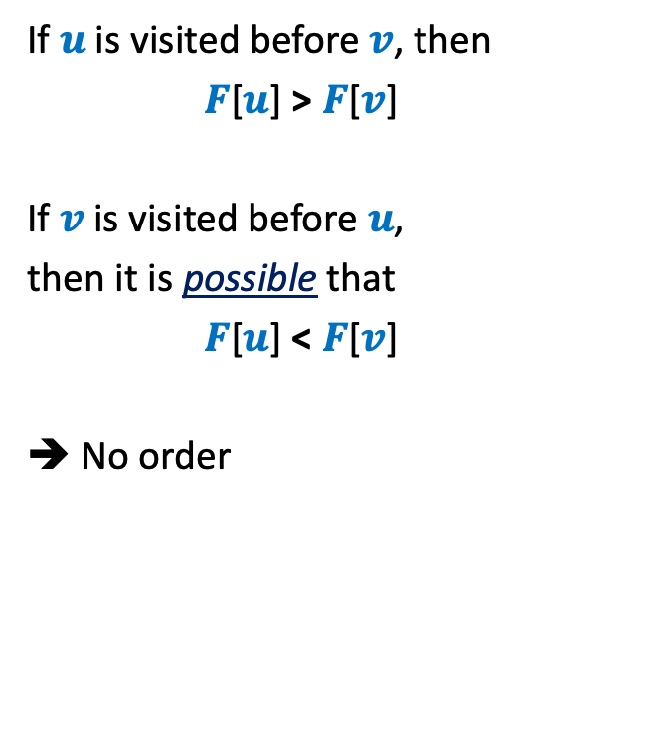



DFS on Directed Graph: analyzing the finish time
Case 1: $u$ and $v$ belong to same SCC.
If $u$is visited before $v$, then
$F$[$u$] > $F$[$v$]
If $v$is visited before $u$,
then it is possible that
$F$[$u$] < $F$[$v$]
➔ No order
$$u$$
$$v$$
Is there any relation between $F$[$u$] and $F$[$v$] ?

Slide 25
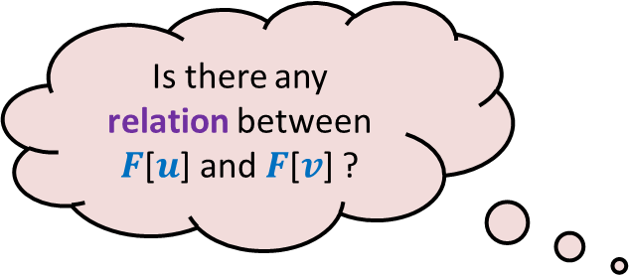
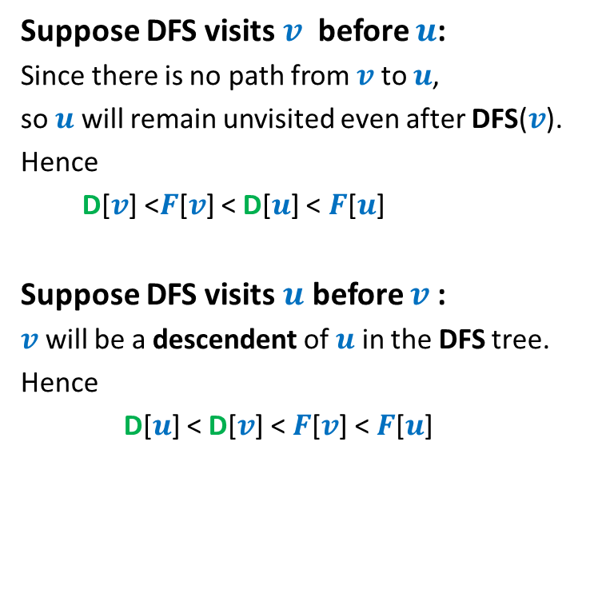


DFS on Directed Graph: analyzing the finish time
Case 2: $u$ and $v$ belong to different SCC.
Suppose DFS visits $v$ before $u$:
Since there is no path from $v$ to $u$,
so $u$ will remain unvisited even after DFS($v$).
Hence
D[$v$] <$F$[$v$] < D[$u$] < $F$[$u$]
Suppose DFS visits $u$ before $v$:
$v$ will be a descendent of $u$ in the DFS tree.
Hence
D[$u$] < D[$v$] < $F$[$v$] < $F$[$u$]
$$u$$
$$v$$
Is there any relation between $F$[$u$] and $F$[$v$] ?
F[$u$] > F[$v$] always !!

Slide 26



DFS on Directed Graph: analyzing the finish time
Lemma3: If ($u$,$v$) is an edge and, $u$ & $v$ belong to different SCCs, then F[$u$] > F[$v$]
F[root($S_{2}$)] ? F[root($S_{1}$)]
Homework: Give a short proof based on Lemma 3. It is just there …
Finally we discovered an order
among the finish times
of the roots of SCCs.
$$u$$
$$v$$
$$S_{2}$$
$$S_{1}$$
>

Slide 27
Searching for an order using Finish time
SCC A
SCC B
Increasing order of F[]
Can there be an edge from some vertex of A to some vertex of B ?
NEVER

Slide 28
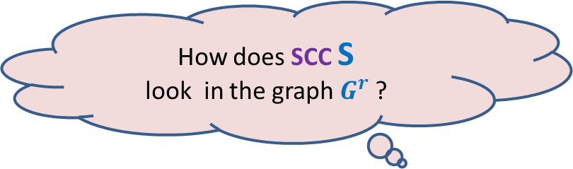

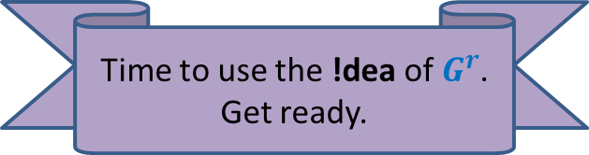
Searching for an order using Finish time
What can we infer for the vertex with max finish time ?
$$u$$
SCC S
$$u$$
SCC S
There won’t be any edge from some vertex outside S into S in $G$.
How does SCC S
look in the graph $G^{r}$ ?
Time to use the !dea of $G^{r}$.
Get ready.

Slide 29


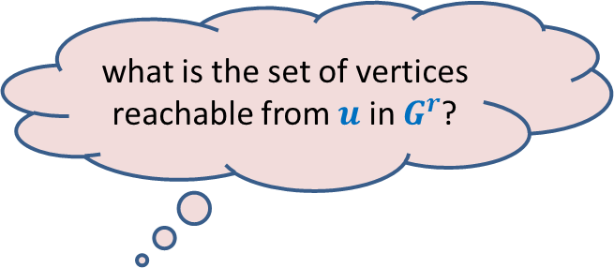
what is the set of vertices reachable from $u$ in $G^{r}$?
$$u$$
Answer: SCC of $u$.
Can you see an algorithm for computing SCCs now ?
It is just here … ☺
SCC S
$$u$$
SCC S
There won’t be any edge from any vertex in S to any vertex outside S in $G^{r}$.

Slide 30
Algorithm for computing SCCs
SCC A
SCC D
SCC B
SCC C
How should we compute SCCs ?

Slide 31


Algorithm for computing SCCs
Execute BFS or DFS on $x$ in $G^{r}$
Remove SCC C
$$x$$
SCC C

Slide 32


Algorithm for computing SCCs
Execute BFS or DFS on $x$ in $G^{r}$
Remove SCC C
Execute BFS or DFS on $y$ in $G^{r}$
Remove SCC D
SCC D
$$y$$

Slide 33


Algorithm for computing SCCs
Execute BFS or DFS on $x$ in $G^{r}$
Remove SCC C
Execute BFS or DFS on $y$ in $G^{r}$
Remove SCC D
Execute BFS or DFS on $z$ in $G^{r}$
Remove SCC B
$$z$$
SCC B

Slide 34

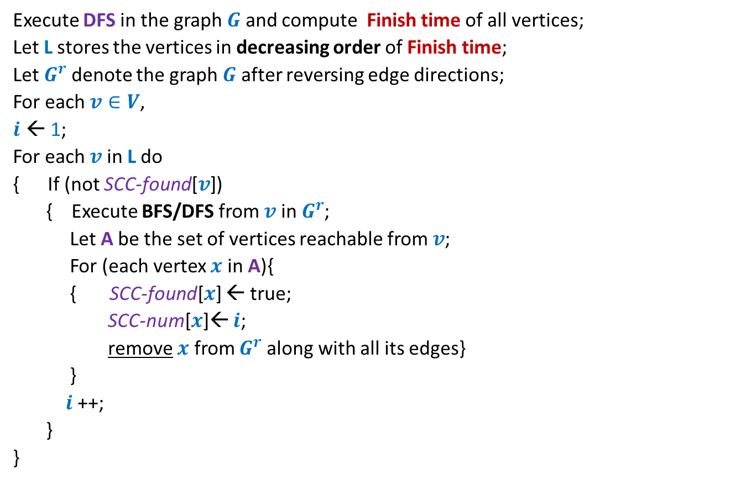
Algorithm for computing SCCs
Execute DFS in the graph $G$ and compute Finish time of all vertices;
Let L stores the vertices in decreasing order of Finish time;
Let $G^{r}$denote the graph $G$ after reversing edge directions;
For each $v∈V$,
$i$ ← 1;
For each $v$ in L do
{ If (not SCC-found[$v$])
{ Execute BFS/DFS from $v$ in $G^{r}$;
Let A be the set of vertices reachable from $v$;
For (each vertex $x$ in A){
{ SCC-found[$x$] ← true;
SCC-num[$x$]← $i$;
remove $x$ from $G^{r}$along with all its edges}
}
$i$ ++;
}
}
SCC-found[$v$]
← false ;

Slide 35
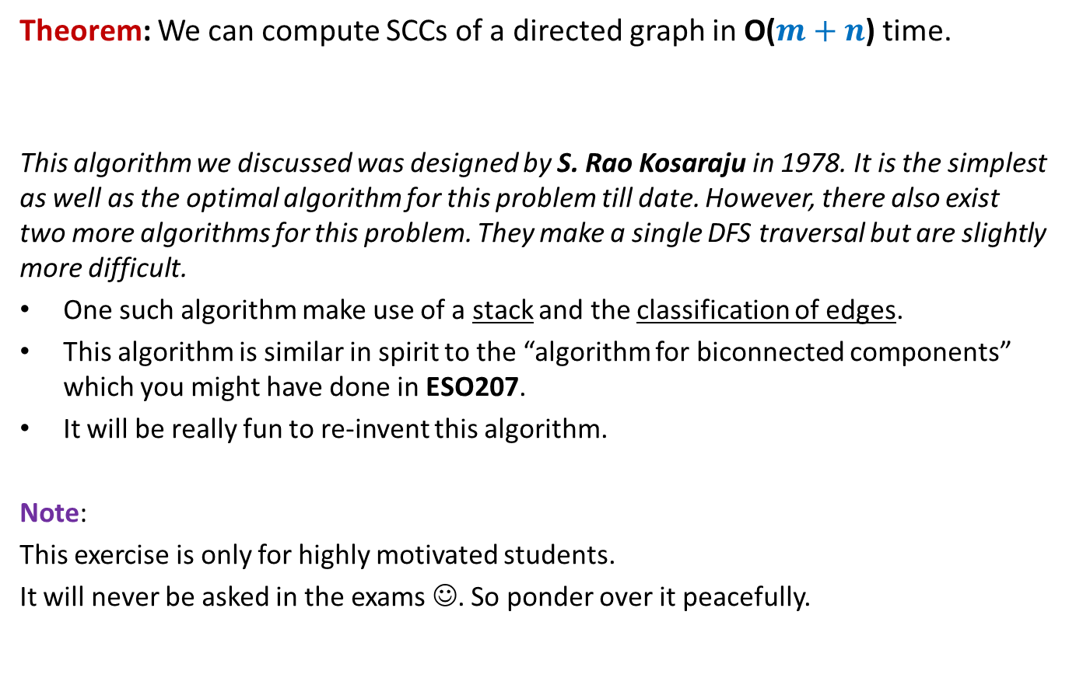
Conclusion
Theorem: We can compute SCCs of a directed graph in O($m+n$) time.
This algorithm we discussed was designed by S. Rao Kosaraju in 1978. It is the simplest as well as the optimal algorithm for this problem till date. However, there also exist two more algorithms for this problem. They make a single DFS traversal but are slightly more difficult.
One such algorithm make use of a stack and the classification of edges.
This algorithm is similar in spirit to the “algorithm for biconnected components” which you might have done in ESO207.
It will be really fun to re-invent this algorithm.
Note:
This exercise is only for highly motivated students.
It will never be asked in the exams ☺. So ponder over it peacefully.

Slide 36
S. Rao Kosaraju is an alumnus of IIT Kharagpur,
and currently at John Hopkins university.
I am sure there will at least a few students
among you who will do some equally fundamental
work in algorithms in the years to come … Best wishes ☺

Slide 37
SCC graph of $G$

Slide 38


SCC graph
x
{x,y}
y
u
v
q
{u,v,w,j}
{p,q,r}
w
j
r
p
{t}
{k}
t
k
{b,c,d}
b
d
h
{h}
c
$$G$$
SCC graph of $G$

Slide 39
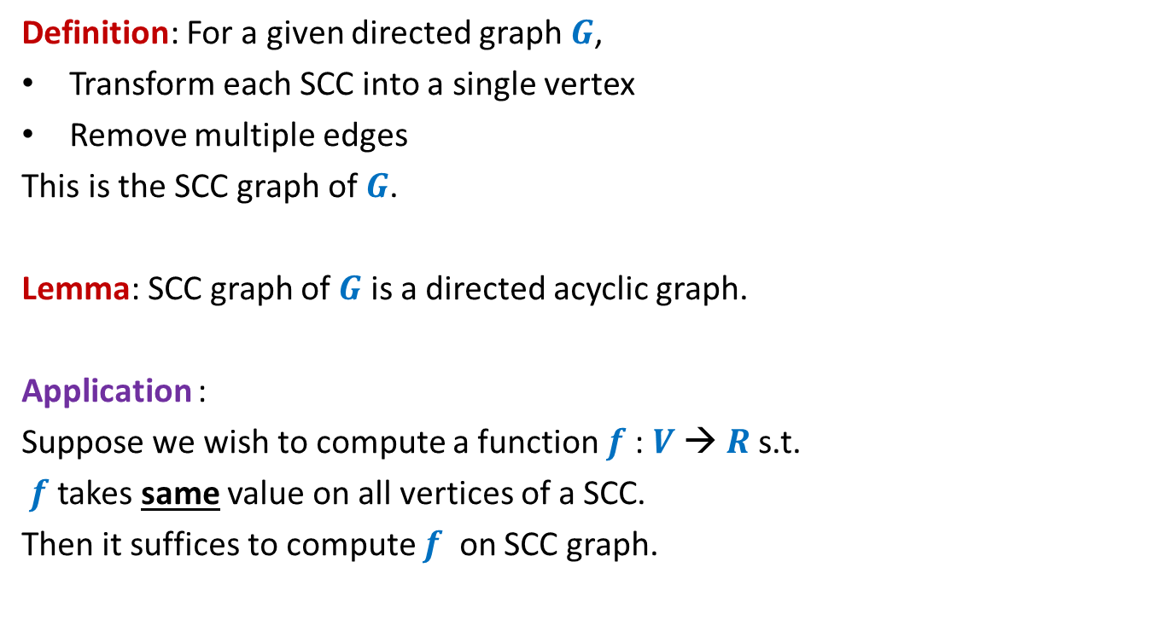
SCC graph
Definition: For a given directed graph $G$,
Transform each SCC into a single vertex
Remove multiple edges
This is the SCC graph of $G$.
Lemma: SCC graph of $G$ is a directed acyclic graph.
Application :
Suppose we wish to compute a function $f$: $V$→ $R$s.t.
$f$ takes same value on all vertices of a SCC.
Then it suffices to compute $f$ on SCC graph.

